Slide 1
Survey Research
Chapter Seventeen

Slide 2
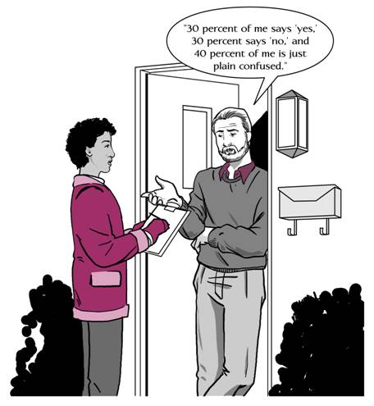
Survey Research
Chapter Seventeen

Slide 3
What is a Survey?
Researchers are often interested in the opinions of a large group of people about a particular topic or issue.
There are three major characteristics that most surveys possess:
    Information is collected from a group of people in order to describe some aspect of the population
    Information is collected by asking questions of the members of the selected group
    Information is collected from a sample rather than from every member of the population

Slide 4
Why Are Surveys Conducted?
The purpose of surveys is to describe the characteristics of a population.
Researchers find out how the members of a population distribute themselves on one or more variables.
A selected sample is surveyed and the description of the population is inferred from what is found out about the sample.
In descriptive surveys, researchers are not as concerned about why the observed distribution exists as with what the distribution is.

Slide 5
Types of Surveys
There are two types of surveys:
    Cross-sectional survey
      Collects information from a sample that has been drawn from a predetermined population
      Information is collected at just one point in time, even though it could take days to gather all the data
      A census is when the entire population is surveyed
    Longitudinal survey
      Information is collected at different points in time in order to study changes over time
      Three types are employed:
        Trend study
        Cohort Study
        Panel Study

Slide 6
Survey Research and
Correlational Research
Techniques of Correlational Research can be tied in with Survey Research.
Researchers could look at the relationship of responses to one question (survey) to another, or of a score based on one set of questions to another set.
The use of calculating correlation coefficients or contingency tables could be determined and implemented.

Slide 7
Steps in Survey Research
The following steps are used in conjunction with performing proper surveys in research:
  Defining the problem
  Identifying the target population (unit of analysis)
  Choosing the mode of data collection
    Direct administration
    Mail surveys
    Telephone surveys
    Personal interviews

Slide 8
Advantages and Disadvantages of Survey Data-Collection Methods
(Table 17.1)
Direct
Administration Telephone Mail Interview
Comparative cost Lowest Same Same High
Facilities needed? Yes No No Yes
Require training of questioner? Yes Yes No Yes
Data collection time Shortest Short Longer Longest
Response rate Very high Good Poorest Very high
Group administration possible? Yes No No Yes
Allow for random sampling? Possibly Yes Yes Yes
Require literate sample? Yes No Yes No
Permit follow-up questions? No Yes No Yes
Encourage response to sensitive topics? Somewhat Somewhat Best Weak
Standardization of responses Easy Somewhat Easy Hardest

Slide 9
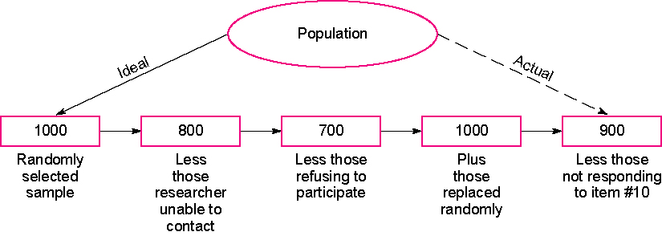
Example of an Ideal vs. an Actual Telephone Sample for a Specific Question (Figure 17.1)

Slide 10
Steps in Survey Research
(cont.)
The following steps are used in conjunction with performing proper surveys in research:
  Selecting the sample
  Preparing the instrument (questionnaire)
    Closed-ended questions
    Open-ended questions
    Pre-testing the questionnaire
    Format
    Cover letter
  Training interviewers

Slide 11
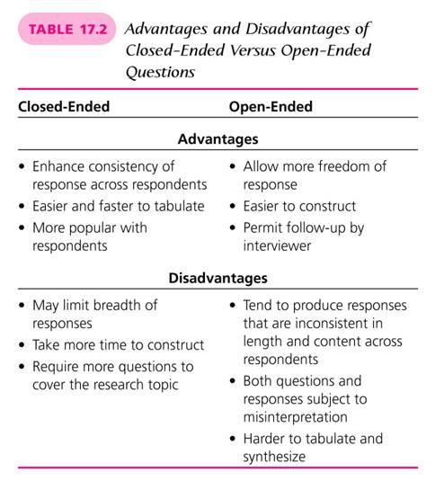
(Table 17.2)

Slide 12
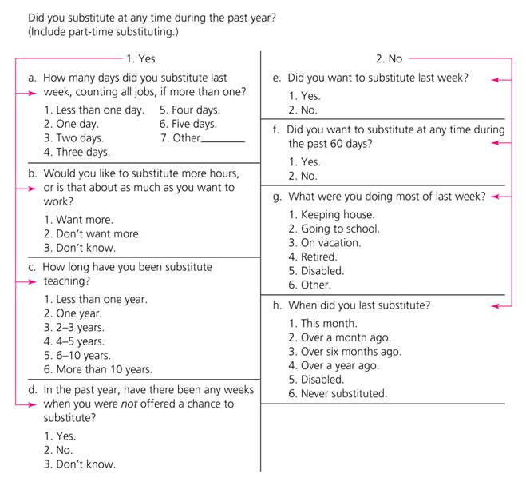
Example of Contingency Questions (Figure 17.2)

Slide 13
Non-response
In almost all surveys, some members of the sample will not respond.
Item non-response is due to unclear or questionable forms of wording.
Non-response is a serious problem in many surveys.
A variety of techniques are employed to reduce this problem (e.g., rewards or incentive for completing the surveys).

Slide 14
Evaluating Threats to Internal Validity in Survey Research
There are four main threats to internal validity in survey research:
  Mortality
  Location
  Instrumentation
  Instrument decay

Slide 15
Data Analysis in Survey Research
After researchers receive the completed questionnaires, the task of summarizing the results remains.
The total size of the sample and total percentage of returns should be reported.
The percentage of the total sample responding for each item should be reported.
The percentage of respondents who chose each alternative for each question should be given.

